Slide 1


UNIT 5: Me and the World
Eat well – feel well

Slide 2

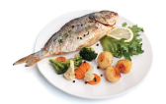

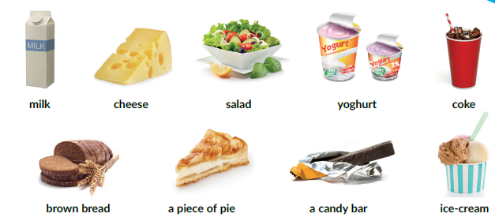
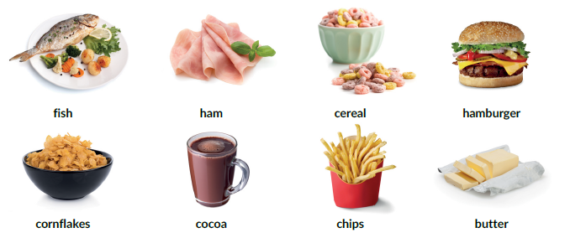
Eat well – feel well
Textbook, p. 86.
Listen to Mia and Pam. Who eats healthy food?
Listen again. Write numbers 1-17 next to the picture that you hear.
8
3
14
2
4
13
6
16
12
1
10
15
7
5
9
11
17

Slide 3
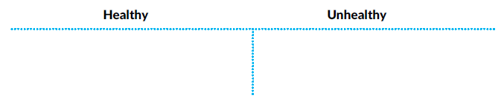
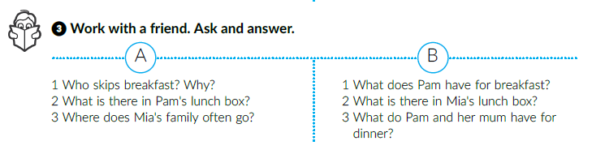
Sort out the words.
fish, cornflakes, milk, cheese, salad, yoghurt, brown bread
ham, cereal, hamburger, cocoa, chips, butter, coke, a piece of pie, a candy bar, ice-cream
1 Mia usually skips her breakfast because she has no time for it.
2 There is a cheese sandwich with brown bread, a carton of yoghurt and an apple in it.
3 Mia and her family often go to a fast food restaurant.
1 Pam eats cornflakes with milk and honey.
2 There is a big sandwich with a lot of butter and ham, a piece of pie, a carton of cocoa and a candy bar.
3 They often have cooked fish, some vegetables and a big bowl of salad.

Slide 4
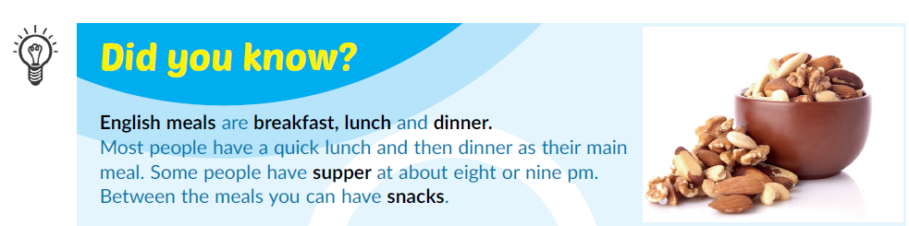
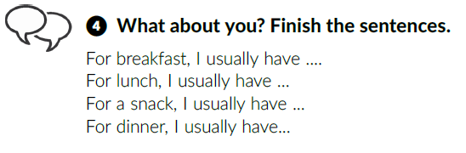


Slide 5
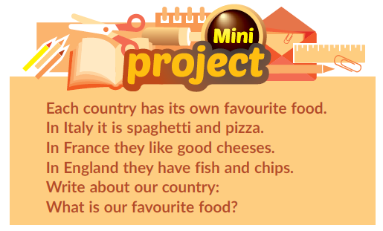
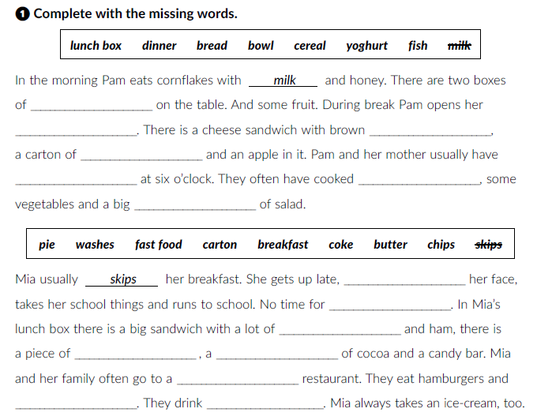
Book, page 89
cereal
lunch box
bread
yoghurt
dinner
fish
bowl
washes
Workbook, p. 59
breakfast
butter
pie
carton
fast food
chips
coke

Slide 6
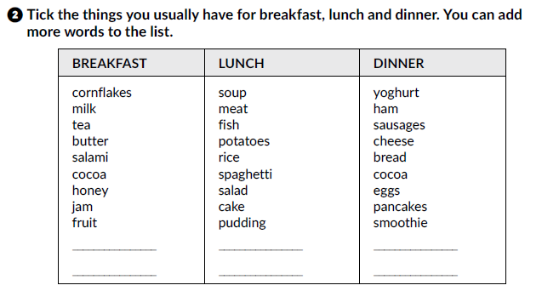
Click on the following link and choose Learn more.
Read the text I love food – but not all! and complete the tasks.
https://www.e-sfera.hr/dodatni-digitalni-sadrzaji/398a2ec1-490a-4044-8e25-3733901422d8/

Slide 7
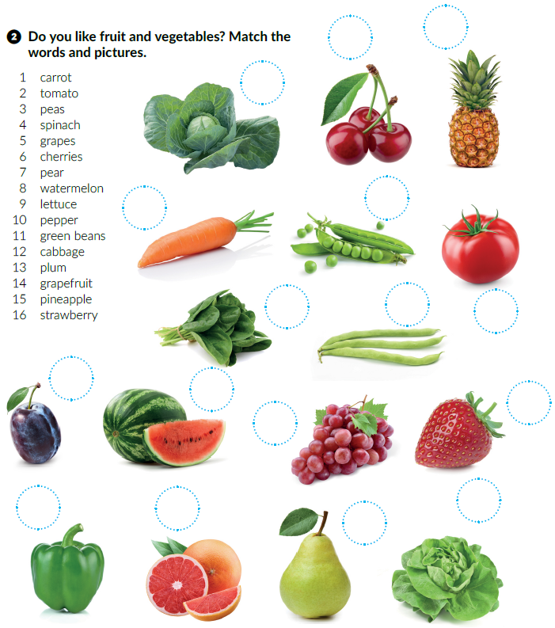
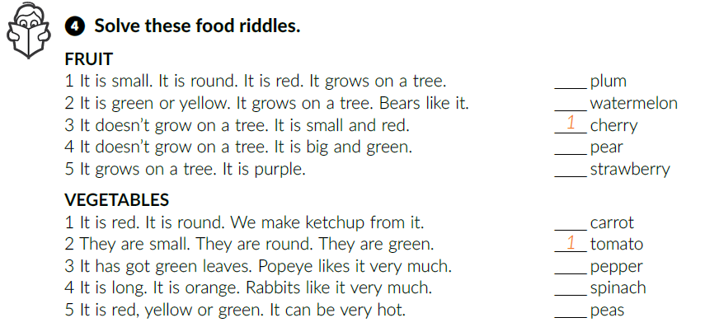
15
What’s your favourite food and drink?
6
12
Textbook, p. 88.
An apple a day keeps the doctor away. Why?
1
3
Copy the words from task 2 in two groups: FRUIT and VEGETABLES.
4
11
2
5
13
4
8
16
5
2
3
4
10
14
9
7
5
3
2

Slide 8
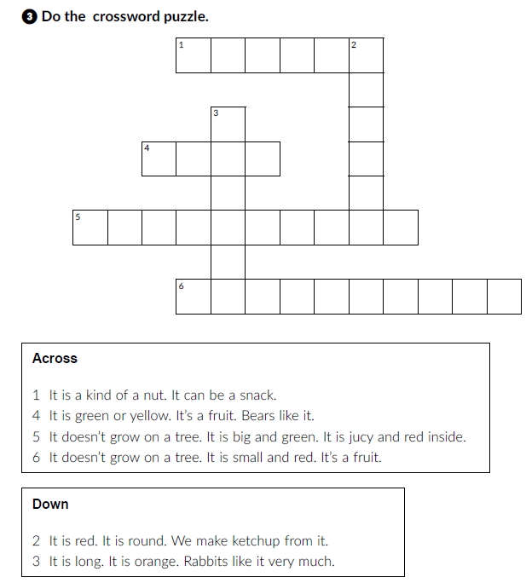
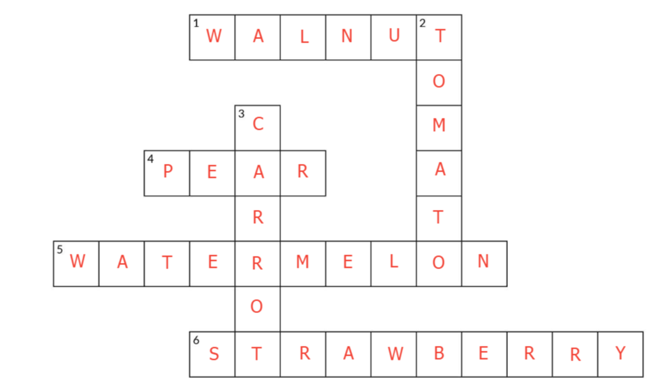
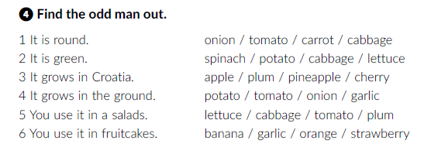
Workbook, p. 60.

Slide 9
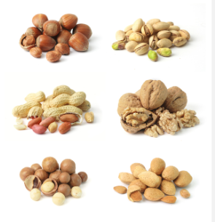
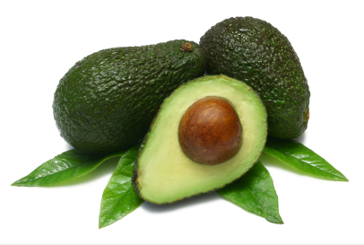
Do you know which food we call superfood?
Click on the following link and choose Learn more and read the text Top 5 superfoods.
https://www.e-sfera.hr/dodatni-digitalni-sadrzaji/398a2ec1-490a-4044-8e25-3733901422d8/
Can you name food that we call superfood?
How often do you eat it?
Why do we call it superfood?

Slide 10
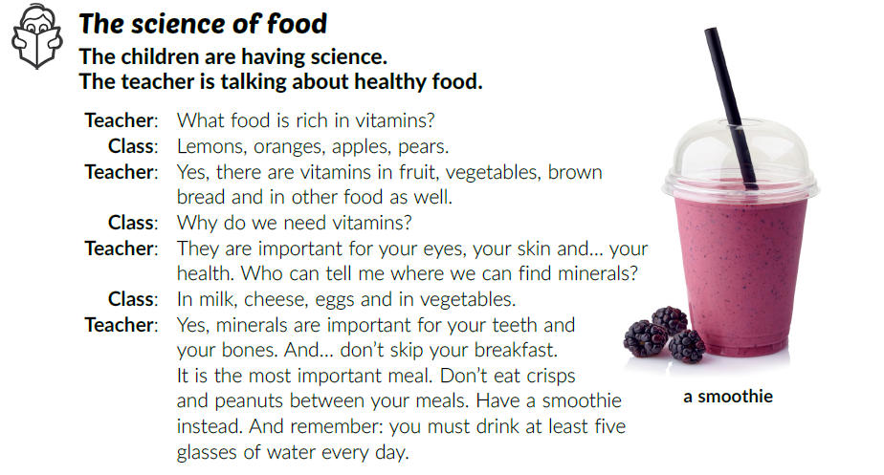
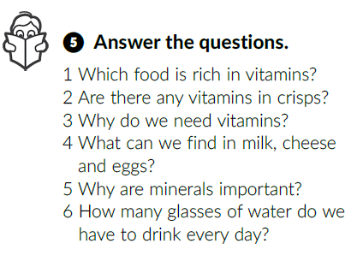
Book, page 89
How often do you have a smoothie?
Do you like it?
Is it healthy?
Read the text and answer the question:
How many glasses of water should we drink every day?
Read the text again and underline healthy food.
Answer the questions in your notebook.

Slide 11
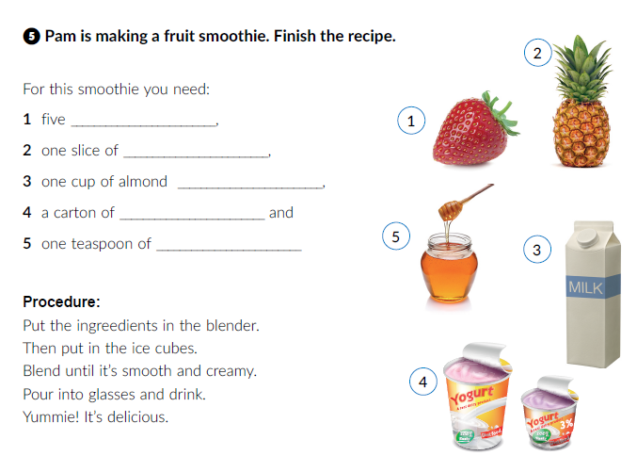
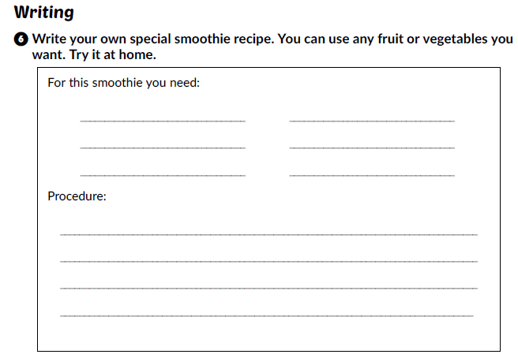
Workbook, p. 61.
strawberries
pineapple
milk
yoghurt
honey
Click on the following link and choose Self check. Complete the tasks.
https://www.e-sfera.hr/dodatni-digitalni-sadrzaji/398a2ec1-490a-4044-8e25-3733901422d8/

